Slide 1
TFL: Pitch deck

Slide 2
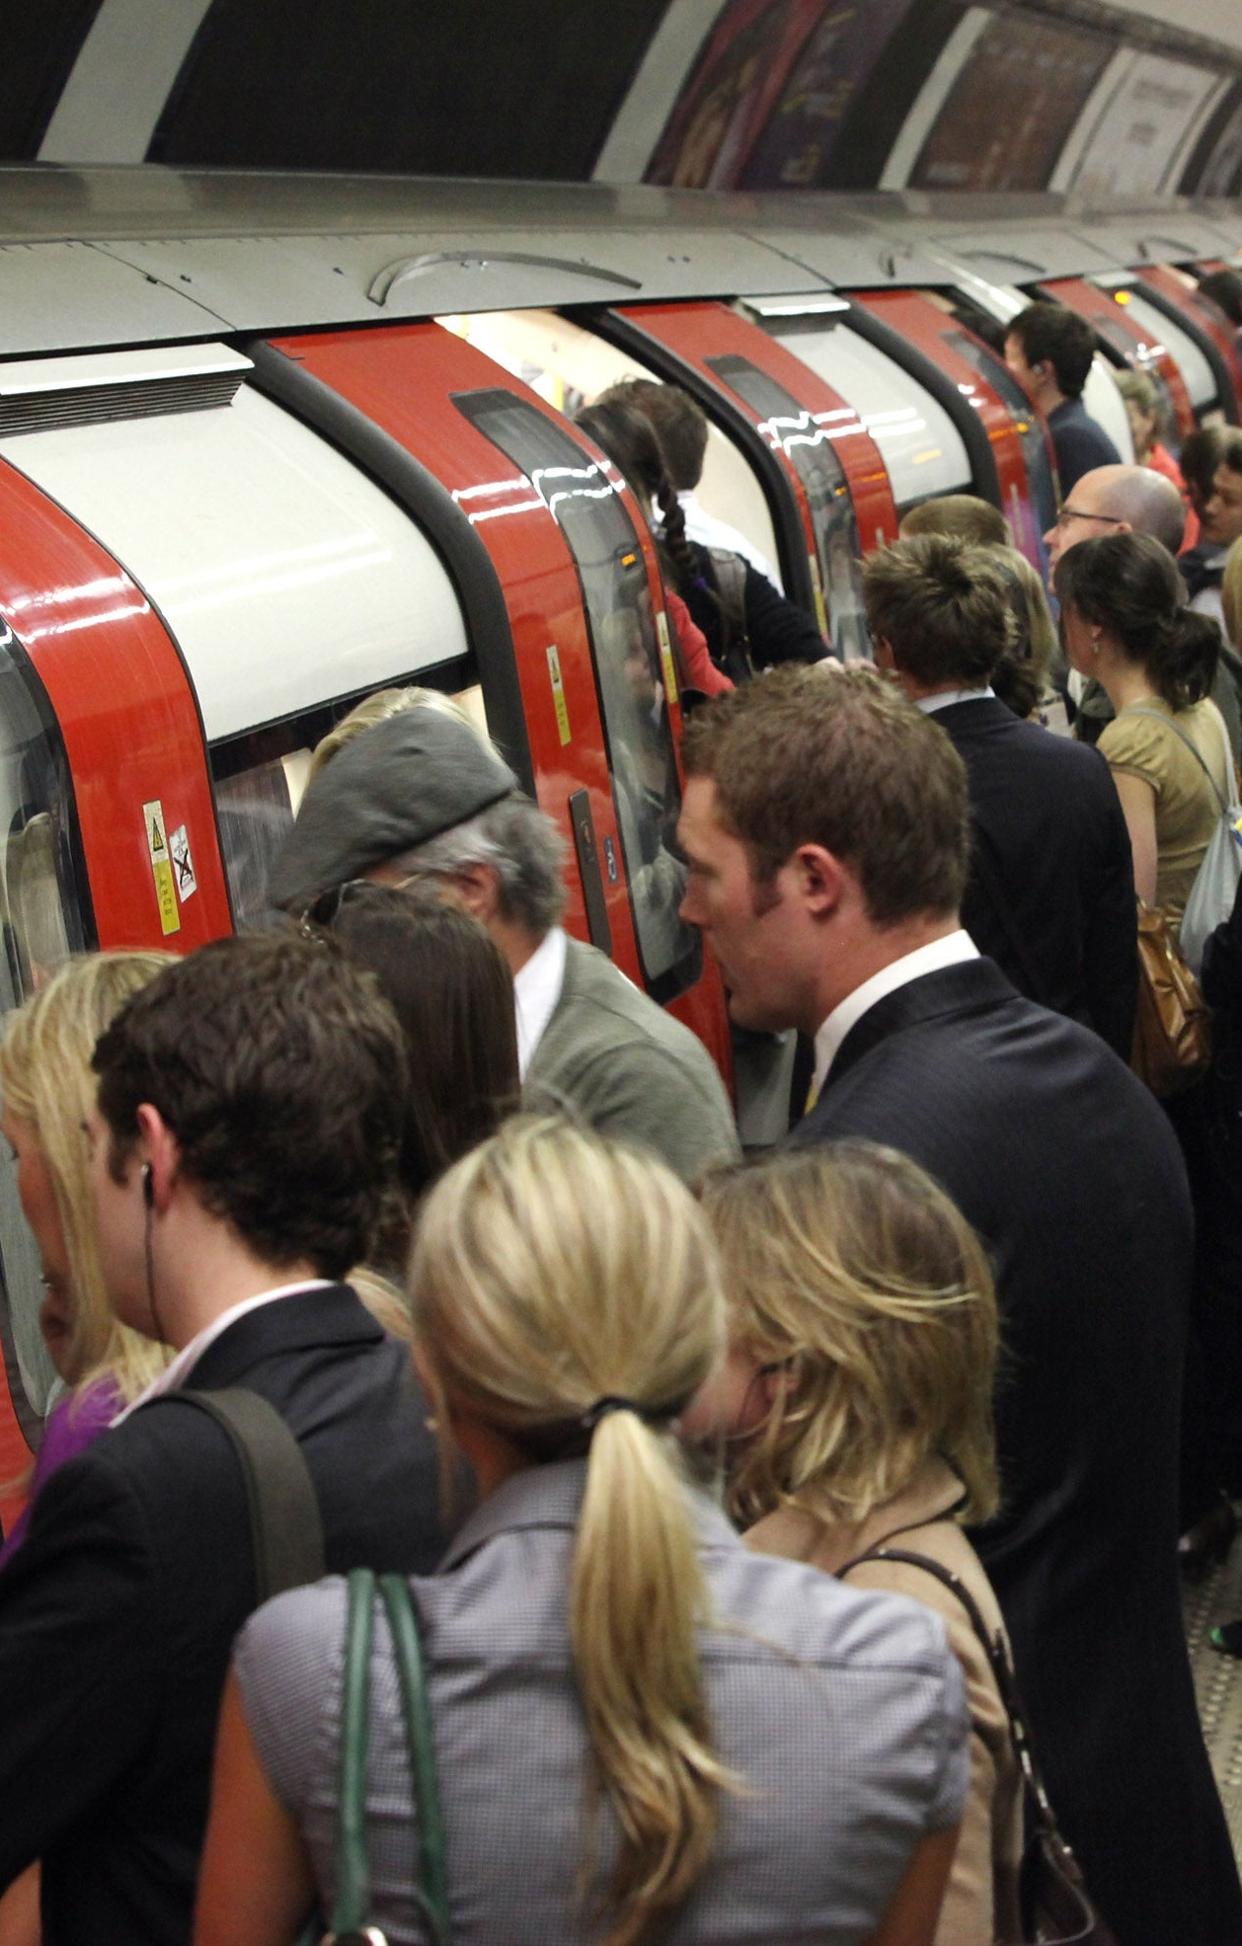
The Problem
Inefficiency in travelling around London leads to overcrowding at stations. This is due to:
An insufficient number of carriages
Infrequent running of train services
Cramped platforms
Small stations

Slide 3
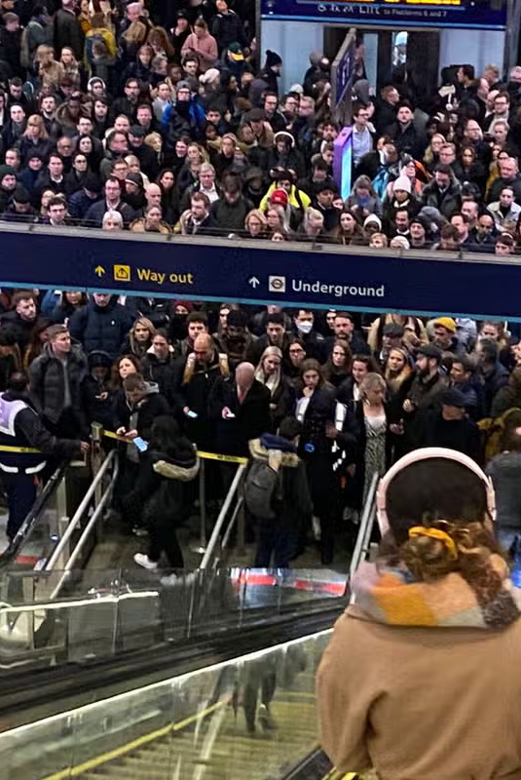
What has been done?
Various solutions in the past such as peak fares and crowd control measures, have all tried and failed to help the problem because the demand for these stations remains unchanged.
Peak fares have rose by 5.9 % in March 2023 this may reduce the number of people using public transport
Crowd control measures such as shutting down ticket gates to restrict customer flow into the station -> journey delays

Slide 4
What Is Already On the Market?
Apps like TFL Go and Google Maps exisit and they alert users as to which stations are overcrowded and what times to travel to avoid peak rush through displaying live crowding information.
This is inefficient as the users must travel regardless, whether it be to work or school and these apps do not provide any alternative solutions, making the information provided irrelevant.
However, there is a gap in the market for an app that implements the crowding data, actively provides a solution to individuals and then generates useable information for commuters.

Slide 5
Our Solution
Is to create an app that redesigns travel routes that will:
Avoid busier stations
Reduce crowding on platforms
Decrease demand for popular stations
This would increase the usage of all stations and improve the flow of human traffic around the city greatly.

Slide 6
How?
The app will utilize data such as the number of passengers at each station, as well as historical figures of overcrowded stations to suggest alternative routes to your travel journey.
The app then returns optimized travel routes based on:
Fare prices
Travel time
Ease of journey i.e., number of changes
All of which can be set and toggled by the customer to create a new individualized route.

Slide 7
Market Size and Target Audience
The Tube handles up to 5 million passenger journeys in a single day. The tube map app only has over 1.5 million active users, so there is a clear demand for travel and journey mappers.
We want to directly impact peak travel times and thereby target the problem at the source, so the intended audience would be anyone who works a '9-5' job.
In London alone the size of the work force is 5.8 million, which would then also translate to the size of our market.

Slide 8
Proof Of Concept
When the user taps on the app they will be able to input their intended destination and current location. The app will then allow them to filter the results shown with options like time spent walking, fare prices and rail cards, as well as max number of changes.
The app will then create various routes to get from A to B, displaying the cost of each journey, which stations they are to avoid due to overcrowding and the travel time for each journey.
This then enables the user to pick a new route of their choice that effectively avoids the overcrowded stations but still allows them to complete their journey in a timely manner.
The app will also allow for individuals to input their own re-routing ideas or the route they ended up taking to provide better information for the next journey.

Slide 9
Attainability
What can we achieve now: An app that is able to plan multiple journeys from A to B that are outside of the more commonly take routes.
What can't we achieve now: An app that optimizes travel routes based off the individuals' preferences and reports fare prices

Slide 10
Resources
Live tracking of the number of people in each station at a certain time
Knowledge of all the different connections and changes that can be made across TFL's public transport
How long it takes to move between stations and connections
Which stations are more likely to get overcrowded to be flagged up as ones to avoid
Fare prices at certain times for specific zones

